Slide 1

JavaScript
Basic Concepts
Mayooran
Tech Lead, Unicom SD
Unicom TIC
11/05/2024

Slide 2
Prerequisites
Strong knowledge in HTML.
Ability to use some basic CSS properties and selectors.
Ability to create simple static website.
What is JavaScript?

Slide 3
Learning Objectives
How to use JavaScript in Web Pages?
What is Function in JavaScript?
What can JavaScript really do?
JavaScript Variables.
JavaScript Operators.

Slide 4
How to Use JavaScript in Web Pages?
In HTML, JavaScript code is inserted between <script> and </script> tags.
<script>
// Your JavaScript goes here
</script>
Example:
<script> document.getElementById("demo").innerHTML = "My First JavaScript"; </script>

Slide 5
How to Use JavaScript in Web Pages?
You can place any number of scripts in an HTML document.
Scripts can be placed in the <body>, or in the <head> section of an HTML page, or in both.
Note: Placing scripts at the bottom of the <body> element improves the display speed, because script interpretation slows down the display.

Slide 6
External JavaScript
Scripts can also be placed in external file: myscript.js
function myFunction() { document.getElementById("demo").innerHTML = "Paragraph changed."; }
Placing scripts in external files has some advantages:
It separates HTML and code
It makes HTML and JavaScript easier to read and maintain
Cached JavaScript files can speed up page loads

Slide 7
JavaScript Display Possibilities
JavaScript can "display" data in different ways:
Writing into an HTML element, using innerHTML.
Writing into the HTML output using document.write().
Writing into an alert box, using window.alert().
Writing into the browser console, using console.log().

Slide 8
JavaScript Functions
A JavaScript function is a block of JavaScript code, that can be executed when "called" for.
For example, a function can be called when an event occurs, like when the user clicks a button.
function checkGuess() {
alert("I am a placeholder");
}

Slide 9
JavaScript Can Change HTML Content
One of many JavaScript HTML methods is getElementById().
document.getElementById("demo").innerHTML = "Hello JavaScript";
Note: JavaScript accepts both double and single quotes

Slide 10
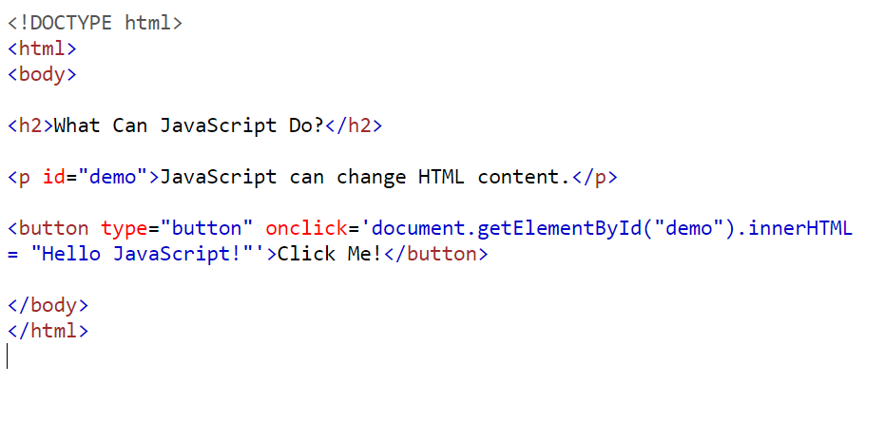
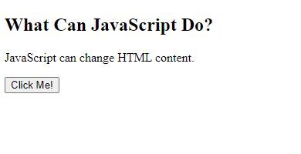
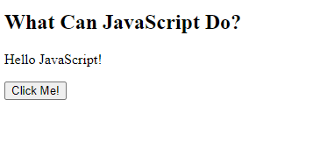

Slide 11
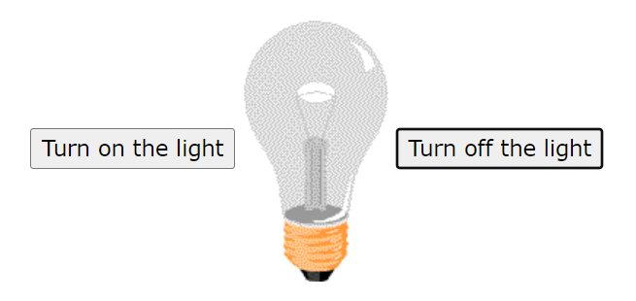
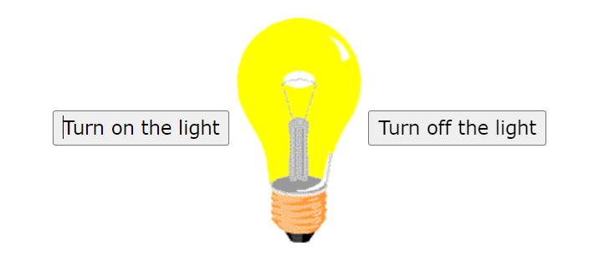
JavaScript Can Change HTML Attribute Values
JavaScript changes the value of the src (source) attribute of an <img> tag:

Slide 12
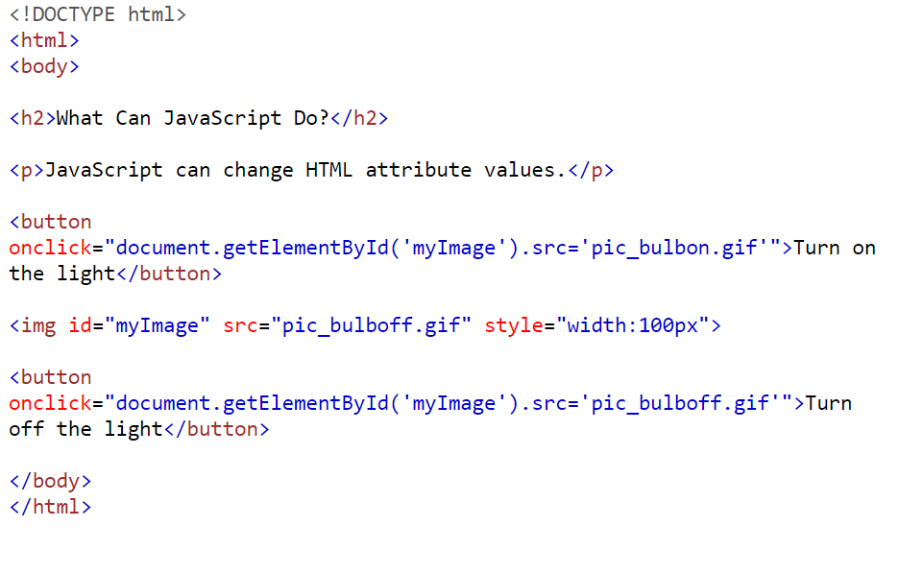

Slide 13
JavaScript Can Change HTML Styles (CSS)
Changing the style of an HTML element, is a variant of changing an HTML attribute.
document.getElementById("demo").style.fontSize = "35px";

Slide 14
JavaScript Can Hide HTML Elements
Hiding HTML elements can be done by changing the display style:
document.getElementById("demo").style.display = "none";

Slide 15
JavaScript Can Show HTML Elements
Showing hidden HTML elements can also be done by changing the display style:
document.getElementById("demo").style.display = "block";

Slide 16
JavaScript Comments
JavaScript comments can be used to explain JavaScript code, and to make it more readable.
Single line comments start with //.
// Change paragraph: document.getElementById("myP").innerHTML = "My first paragraph.";

Slide 17
Multi-line Comments
Multi-line comments start with /* and end with */.
Any text between /* and */ will be ignored by JavaScript.
/* The code below will change the heading with id = "myH" and the paragraph with id = "myP" in my web page: */ document.getElementById("myH").innerHTML = "My First Page"; document.getElementById("myP").innerHTML = "My first paragraph.";

Slide 18
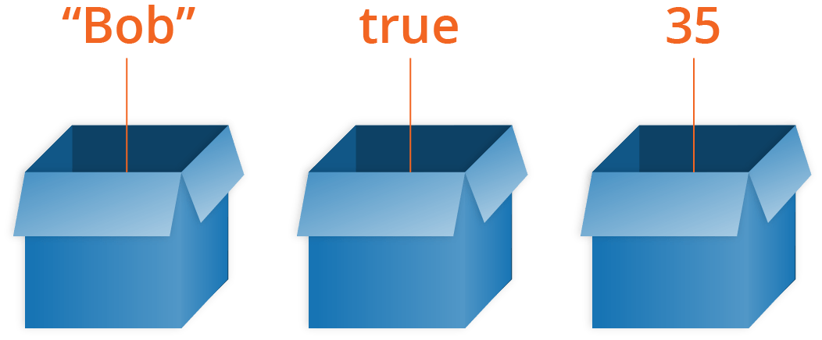
JavaScript Variables
Variables are Containers for Storing Data.
JavaScript Variables can be declared in 4 ways:
Automatically
Using var
Using let
Using const

Slide 19
Automatically
In this first example, x, y, and z are undeclared variables.
They are automatically declared when first used:
x = 5; y = 6; z = x + y;
Note: It is considered good programming practice to always declare variables before use.

Slide 20
Example using var var x = 5; var y = 6; var z = x + y;
Example using let
let x = 5; let y = 6; let z = x + y;
Example using let
const x = 5; const y = 6; const z = x + y;

Slide 21
JavaScript Variables
The var keyword was used in all JavaScript code from 1995 to 2015.
The let and const keywords were added to JavaScript in 2015.
The var keyword should only be used in code written for older browsers.

Slide 22
When to Use var, let, or const?
Always declare variables
Always use const if the value should not be changed
Always use const if the type should not be changed (Arrays and Objects)
Only use let if you can't use const
Only use var if you MUST support old browsers.

Slide 23
JavaScript variable naming
Use Descriptive Names
Use camelCase
Be Consistent
Avoid Reserved Keywords
Avoid Single Letter Names
Use Meaningful Abbreviations
Use Consistent Casing

Slide 24
JavaScript naming convention
Variables: Use camelCase for variable names (e.g., myVariable).
Constants: Use all caps with underscores for constant names (e.g., MY_CONSTANT).
Functions: Use camelCase for function names (e.g., myFunction).
Classes: Use PascalCase for class names (e.g., MyClass).
Constructor Functions: Use PascalCase for constructor functions (e.g., MyConstructor).
Private Variables/Functions: Prefix with an underscore (e.g., _privateVariable, _privateFunction).
Global Variables: Avoid using global variables, but if needed, use descriptive names to minimize conflicts.
Meaningful Names: Choose descriptive and meaningful names to improve code clarity and understanding.
Avoid Reserved Keywords: Avoid using reserved keywords as variable or function names.

Slide 25
JavaScript built-in functions and methods for strings
String Length: length
Accessing Characters: You can access characters in a string using square brackets [].
Substring Extraction: substring(startIndex, endIndex) or slice(startIndex, endIndex)
Substring Search: indexOf(substring) or lastIndexOf(substring)
Changing Case: toUpperCase() and toLowerCase()
Replacing Substrings: replace(oldSubstring, newSubstring)
Trimming Whitespace: trim()
Concatenation: concat(string1, string2, ...)

Slide 26

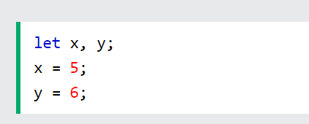
JavaScript Operators
JavaScript uses arithmetic operators ( + - * / ) to compute values:
JavaScript uses an assignment operator ( = ) to assign values to variables:

Slide 27
Any Questions?

